Slide 1


Class Monitor
An Innovative Way to Have Classes! 🤩
Class Monitor 2023

Slide 2
Problem Statement

Slide 3

Teacher
- Hard to manage a big class
- Students have different needs and ability

Slide 4

Student
- Either too hard or too easy
- Boring …

Slide 5

Parent
- Don’t know how to help their children

Slide 6
Class Monitor’s Solution

Slide 7

Simple & User Friendly
- Anytime
- Anywhere
- Simple

Slide 8
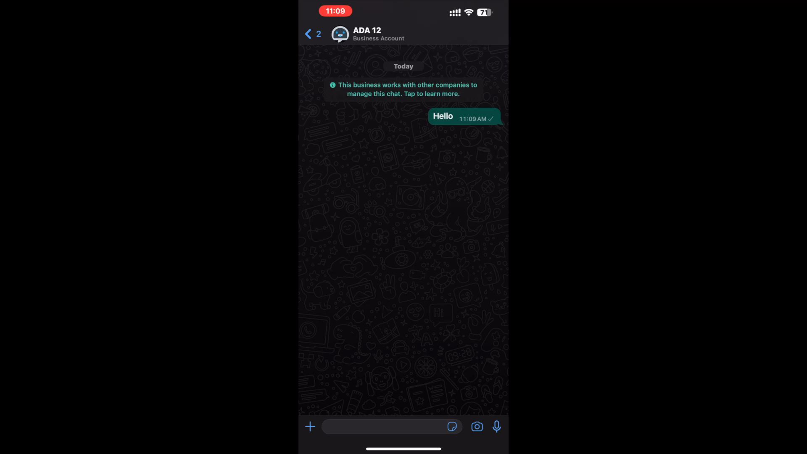
Menu

Slide 9


Comprehensive
Learning Approach
- Quiz
- Realistic and Fun function
- Q&A

Slide 10

AI-Powered Personalization
- Personal Difficulty & Content

Slide 11
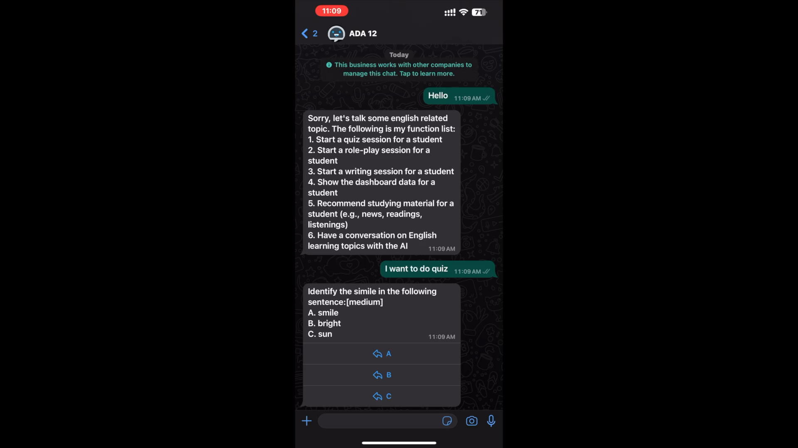
Quiz

Slide 12
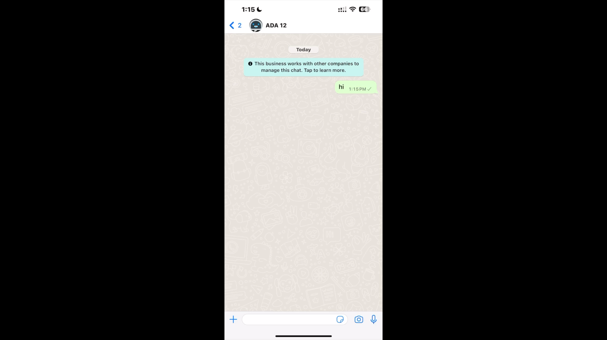
Writing

Slide 13
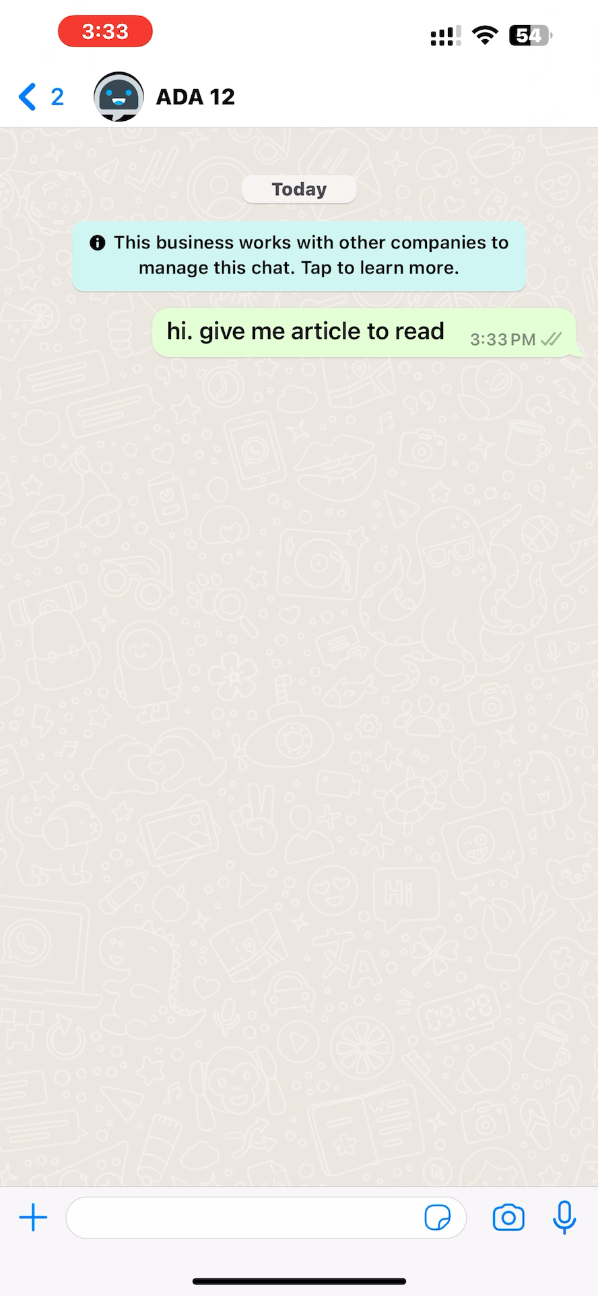
Daily Read

Slide 14
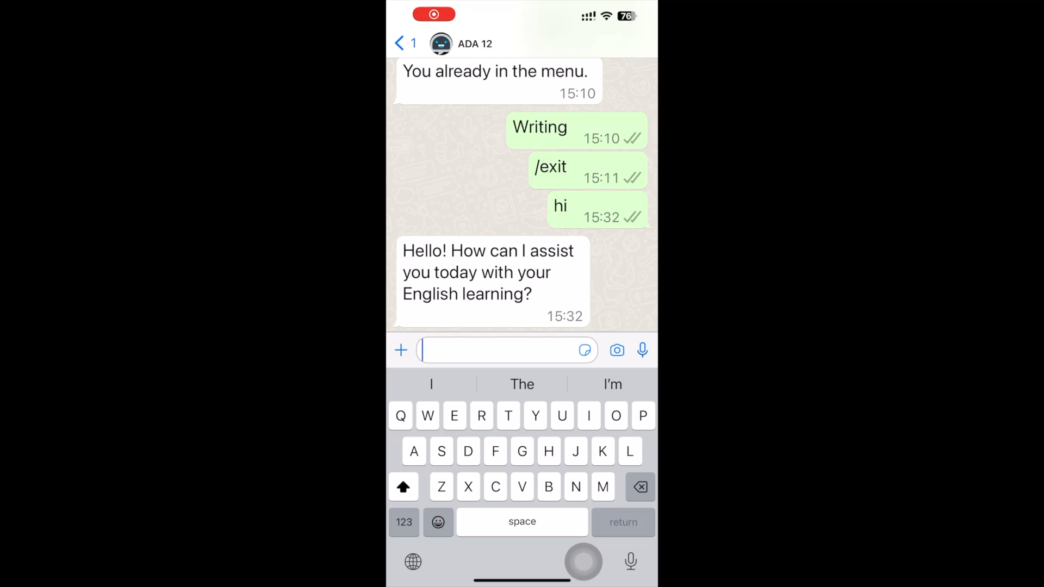
Role Play

Slide 15
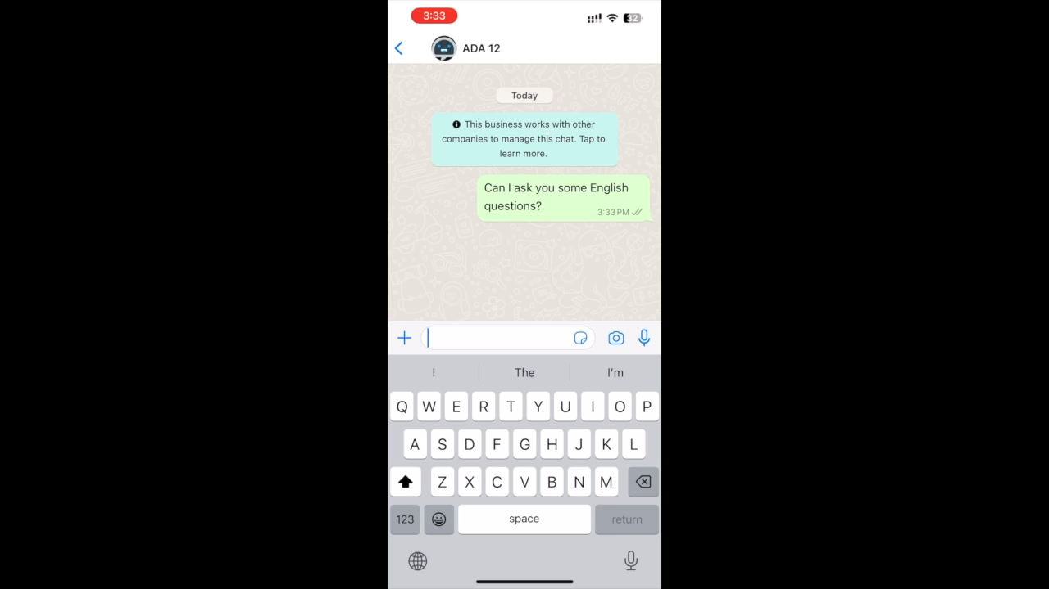
Q&A

Slide 16

Clear Learning Progress
- Smart Chart and Summary
- Drill down analysis

Slide 17
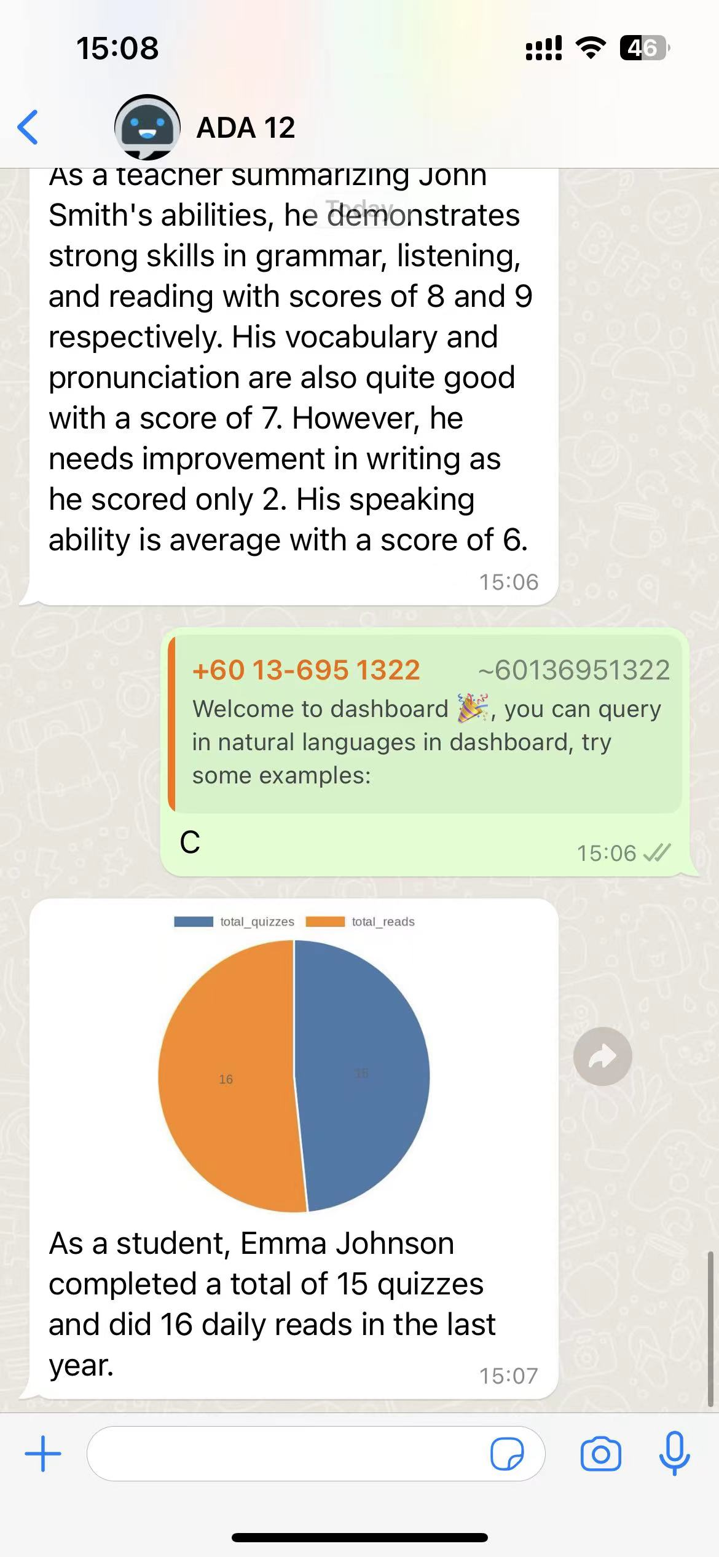
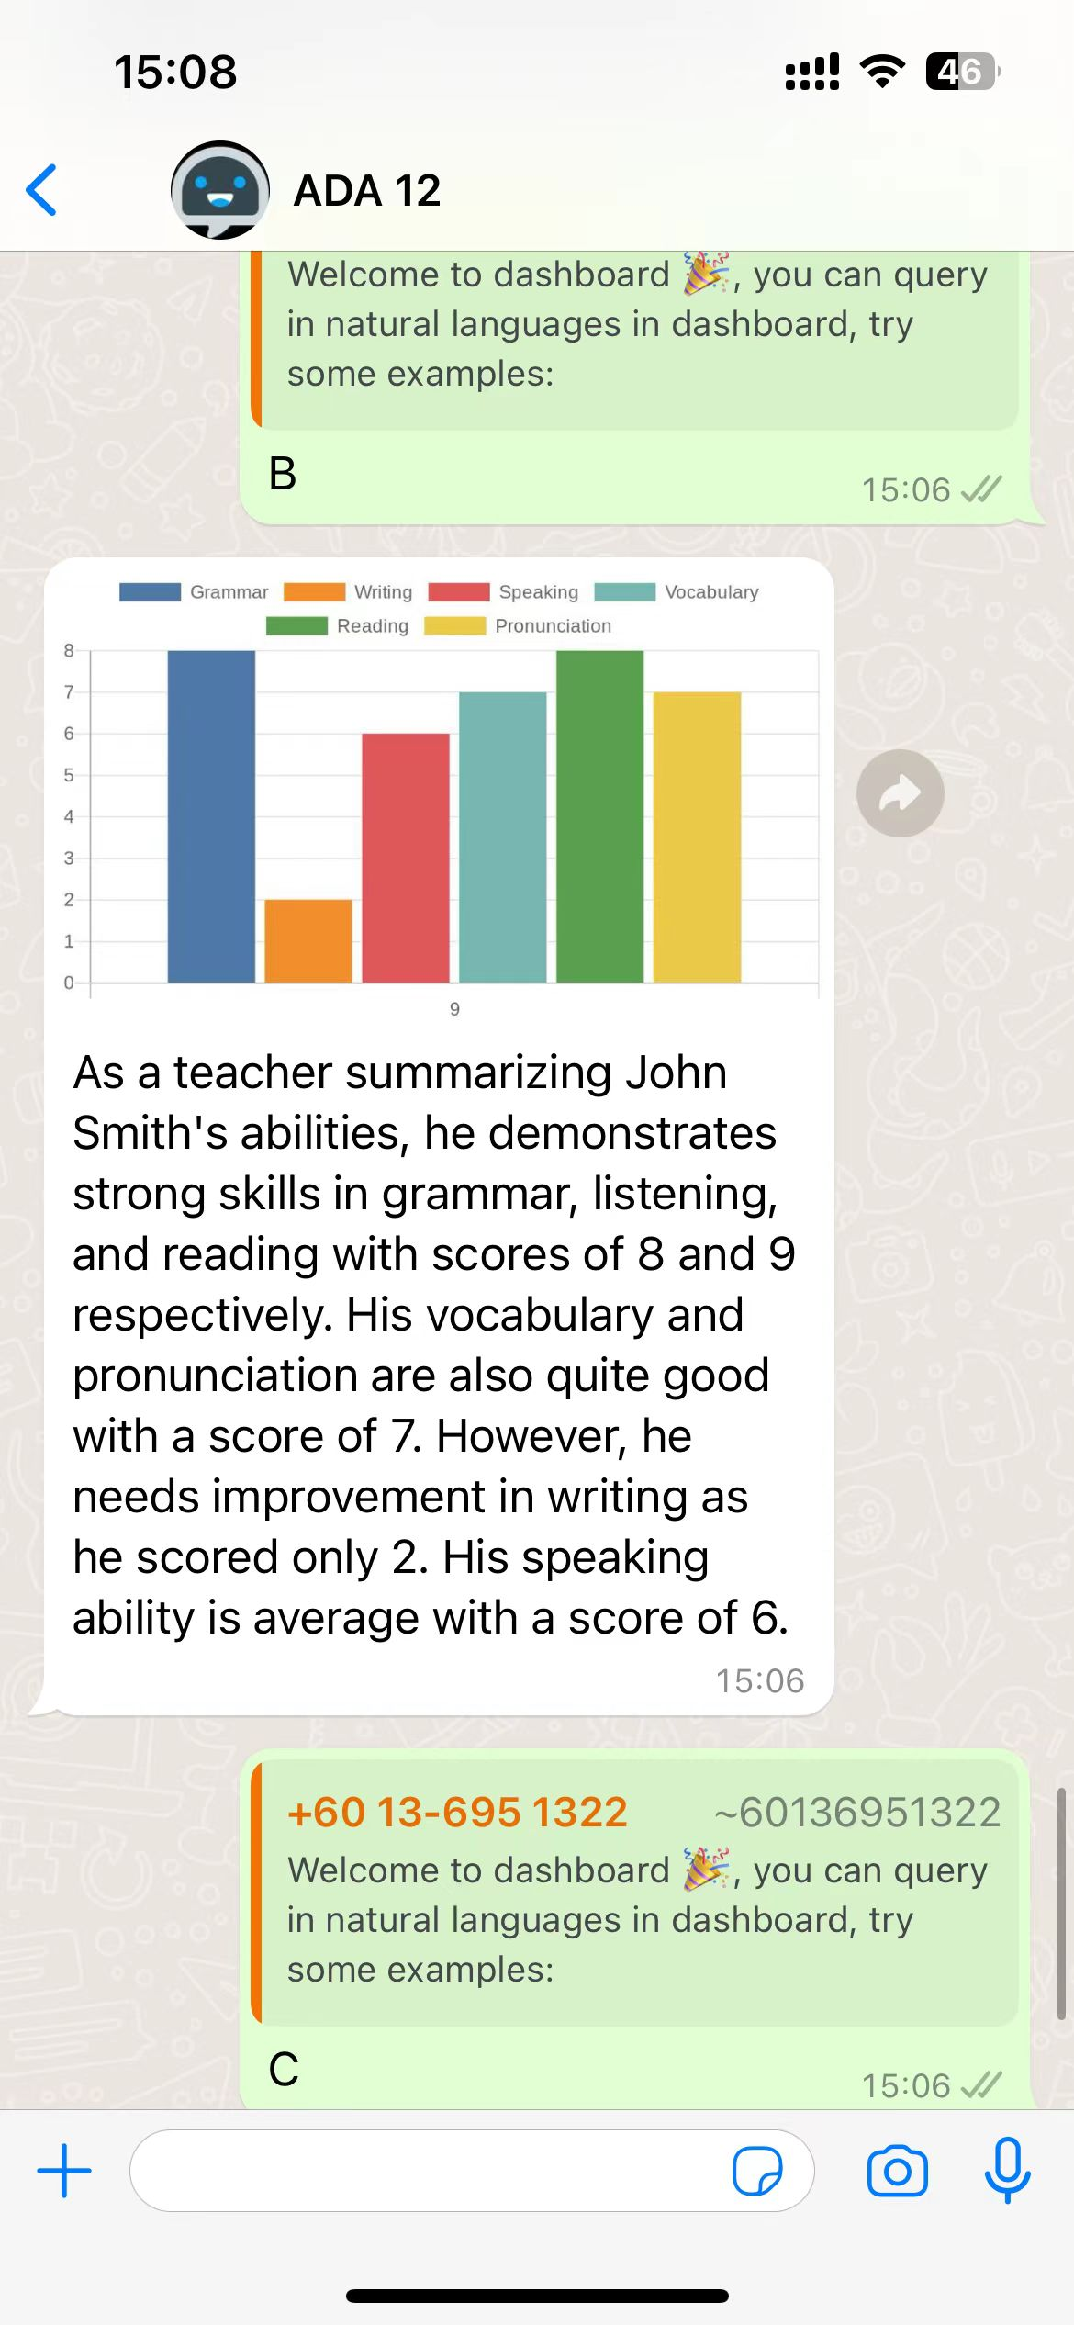
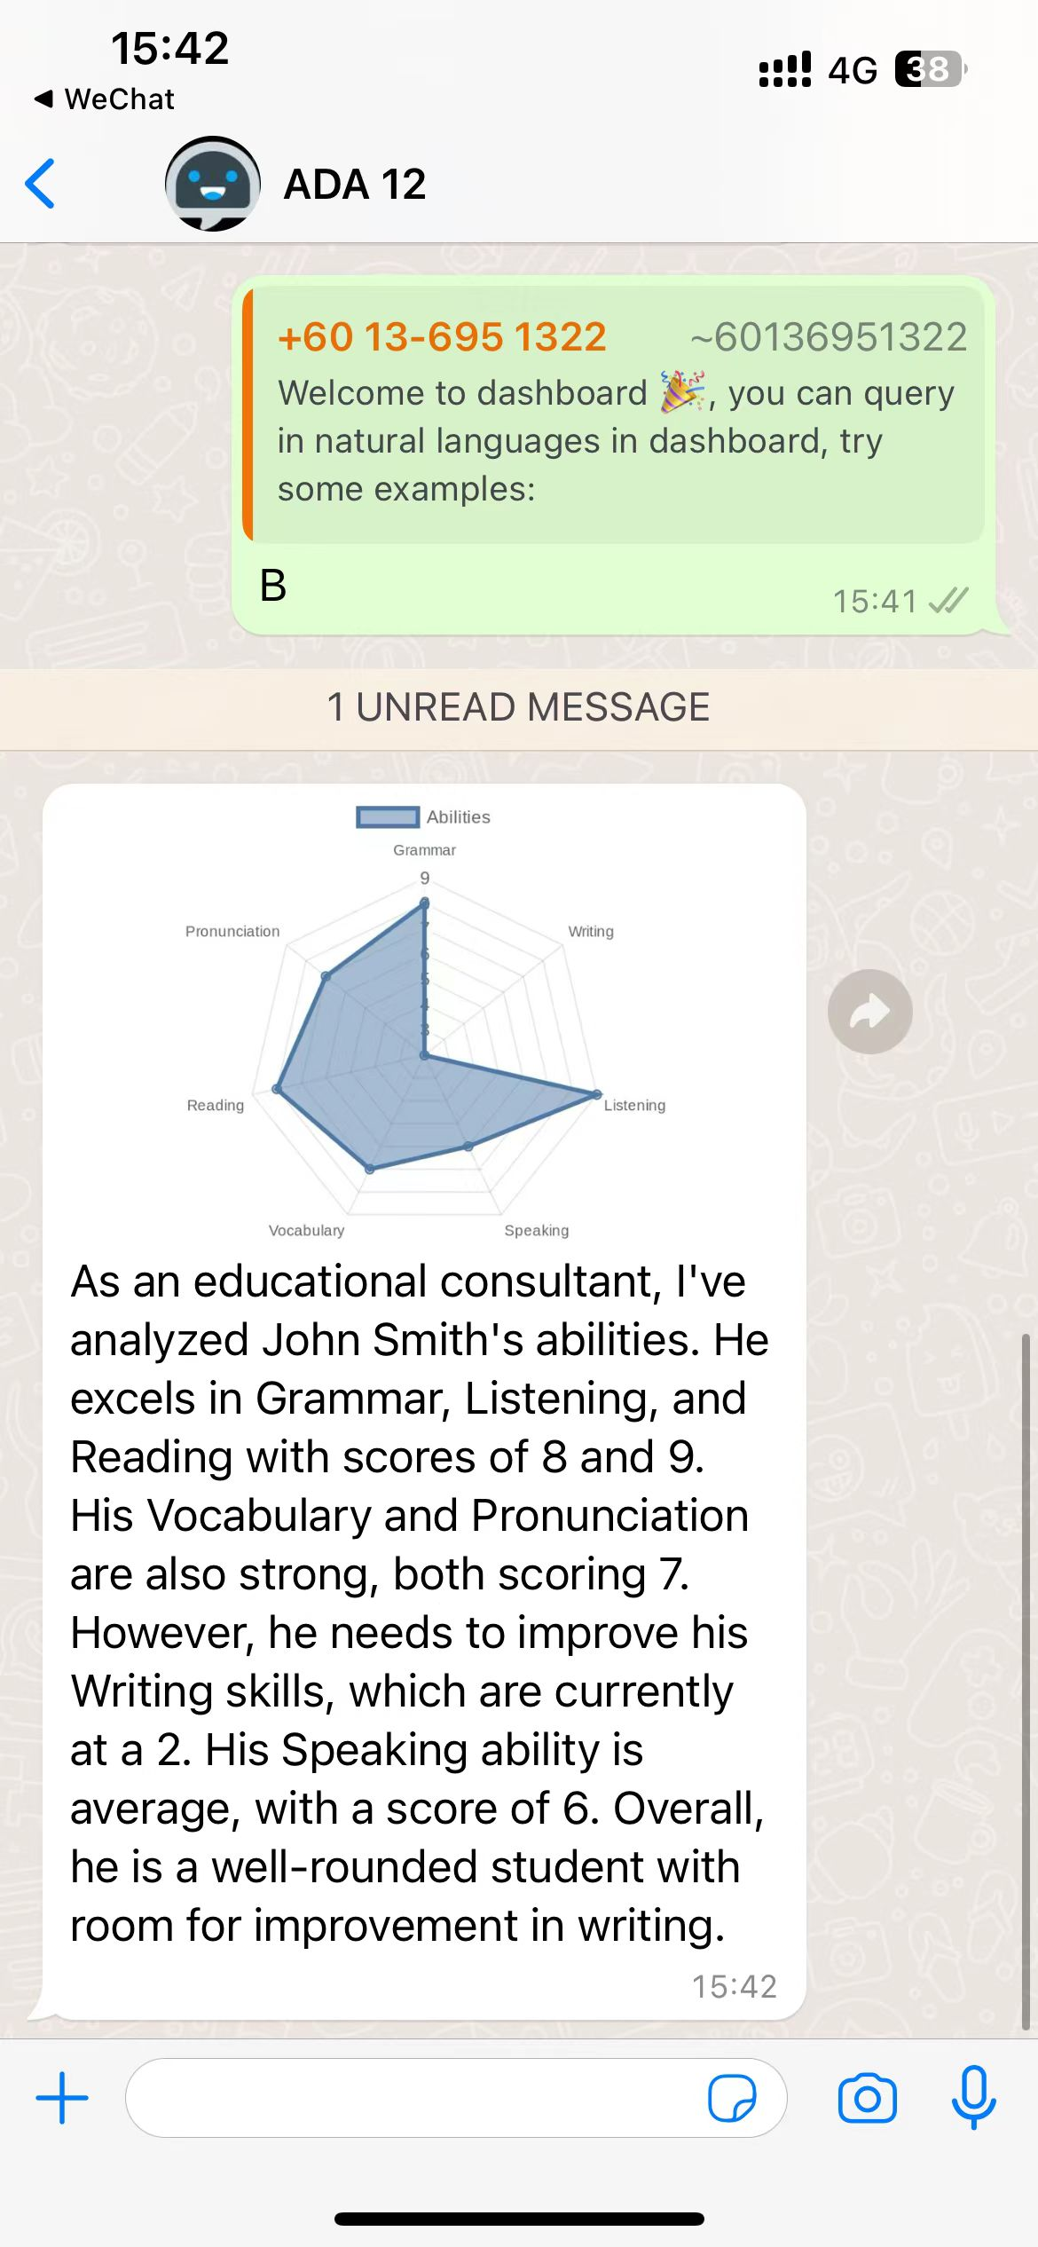
Dashboard

Slide 18
Dashboard

Slide 19

Smart Customization
- AI-powered Question Creation
- Flexible Content Adjustment
- Q&A Summary
- Student Grouping

Slide 20
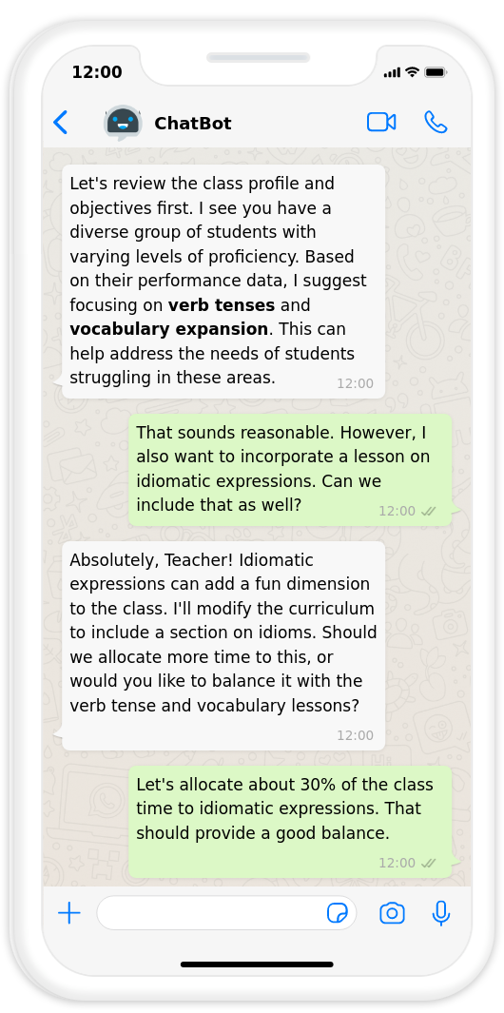
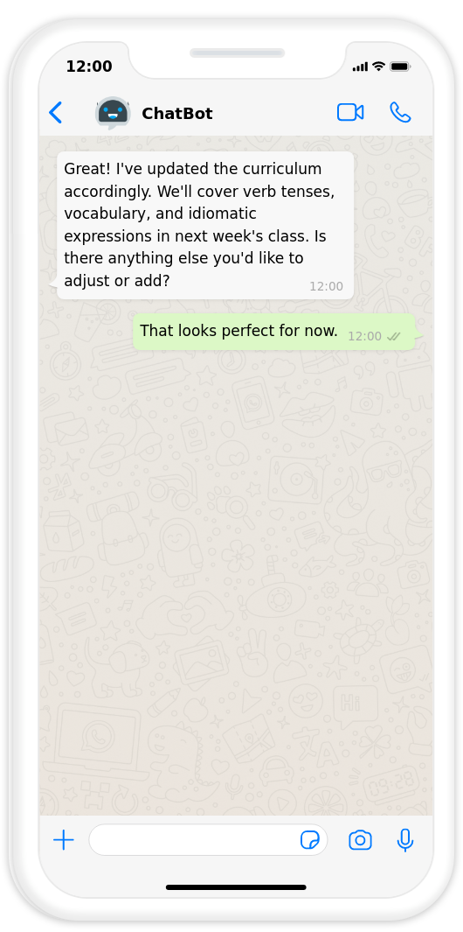
Content Adjustment

Slide 21
Tech Behind

Slide 22
Large Language Model
Framework
Knowledge Base Enhancement
Prompt Engineering
Chain of Thought & Tree of Thought
Function Calling
Multi-Agent Collaboration
Human Involvement Integration
Highly Scalable Framework
Support API
Support User Create Function
Data Security
Anonymization Protocols
Encrypted Storage Systems
Model Trained on non-IDD Data

Slide 23
Business Potential

Slide 24
Estimated Daily Messages: 3M.
Estimated Daily User: 150,000
Estimated Annual Income: US$2M
E
Number of Student: Nearly 1.5 billion people globally are learning a second language. Assume we reach 0.01% of them, then the number of student is 0.15M.

Slide 25
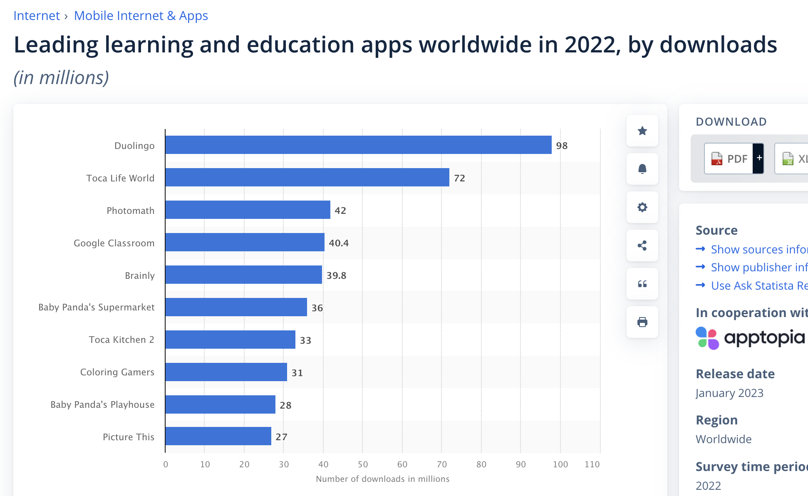
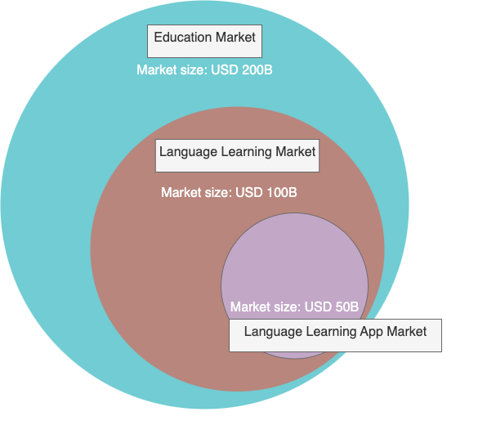
Market Size

Slide 26
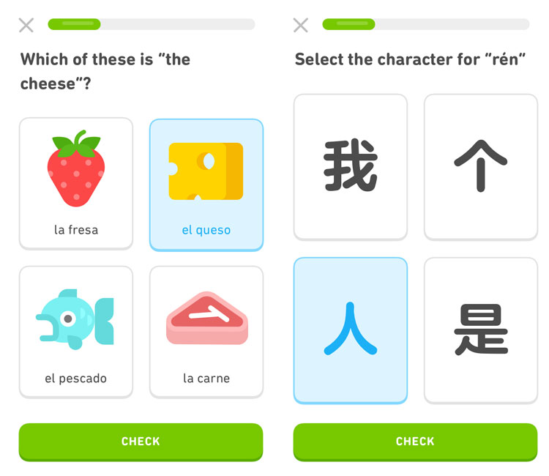
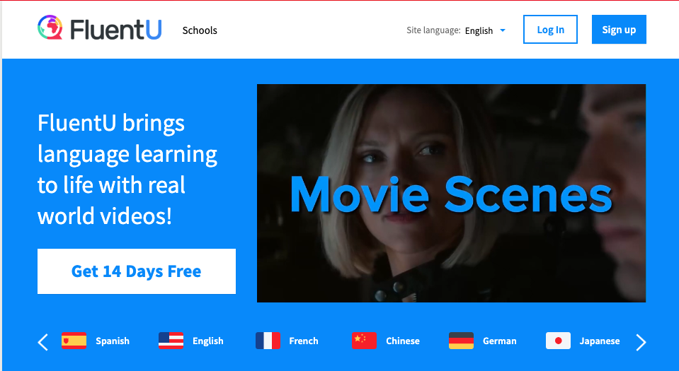
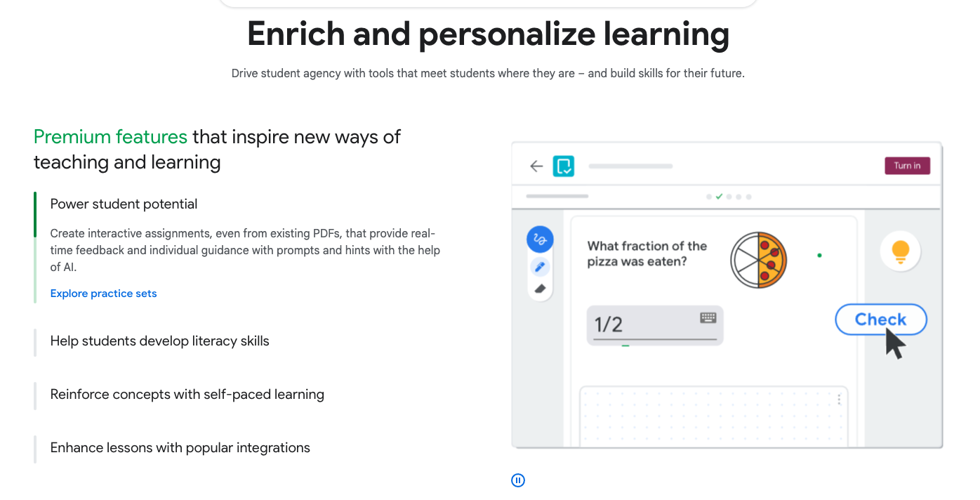



Competitor
Fun, but not comprehensive
Fun, but not comprehensive
Not fun, need effort to create material

Slide 27



Use Case
School
Tutorial Class
Adult Education

Slide 28



Market Expansion
Phrase 1
Phrase 2
Phrase 3
English Language Learning Dominance
Expansion into Other Languages
Expansion into Diverse Subject Matter

Slide 29
Business Model
Phrase 1
Phrase 2
Partnership & Free Trial
Subscription Model

Slide 30
"Your Personalized Learning Journey Starts Here."

Slide 31

Text Class Monitor!
https://wa.me/60136951322

